Slide 1
AWS Serverless
Rob Koch and Matthew Bonig

Slide 2
Outline
Who We Are
Cars and Servers – 15 minutes
Common components of AWS Serverless – 15 minutes
Workflow example – 15 minutes
Q&A – 10 minutes
Notes:
This will likely be removed.

Slide 3

Matthew Bonig
Professional Developer 10+ years
Enterprise/SMB application architect
Node/Angular (recovering .NET)
AWS Certified Solutions Architect
@mattbonig

Slide 4
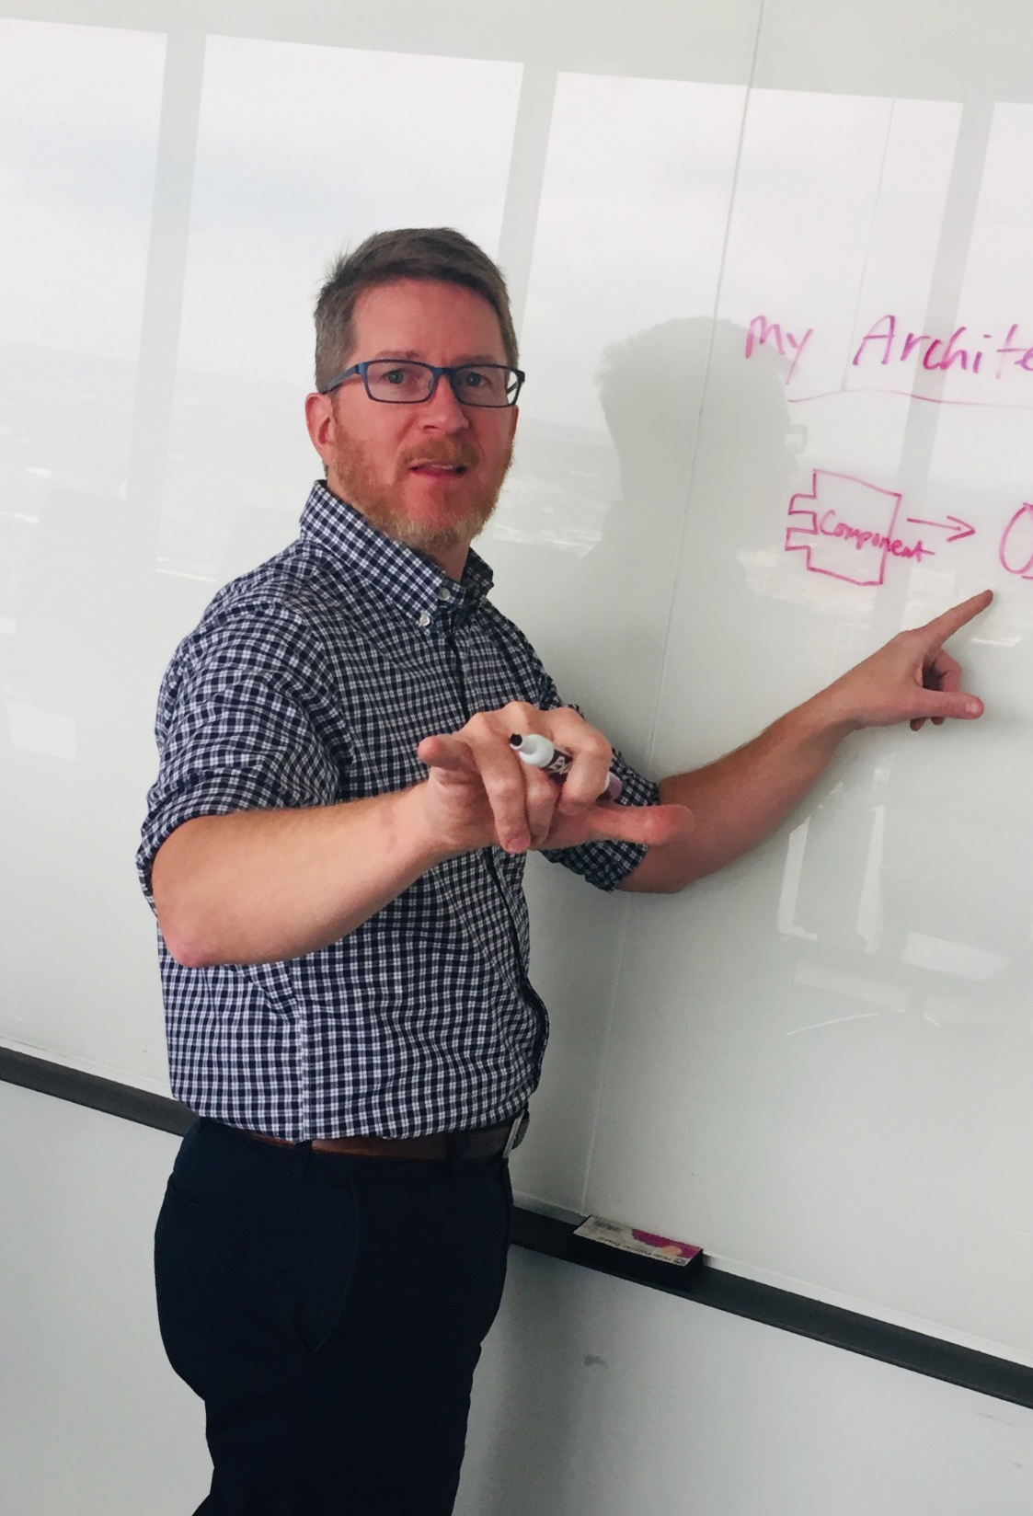
Robert Koch
Graduated with an Economics degree
(Economists knows best)
Lead Architect at S&P Global
.NET Developer – Microsoft stack
Certified Cloud Practitioner
Certified Big Data –Specialty
@robcube

Slide 5
Cars
Notes:
I’ve always liked cars. As a kid I had Lamborghini posters on my wall and loved the Transformers.
When I started thinking about Serverless and why it’s so popular I saw some parallels with the way auto manufacturing has progressed over the years.

Slide 6
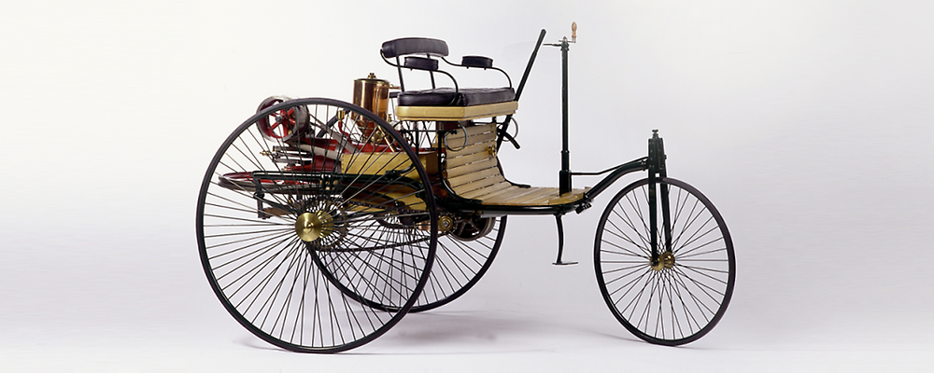
Early Cars – The beginnings
Notes:
In the beginning, there was the Benz Patent Motor Car.
Early days, everything was bespoke. Any parts not created by the manufacturer directly probably weren’t being used elsewhere.
Karl Benz

Slide 7
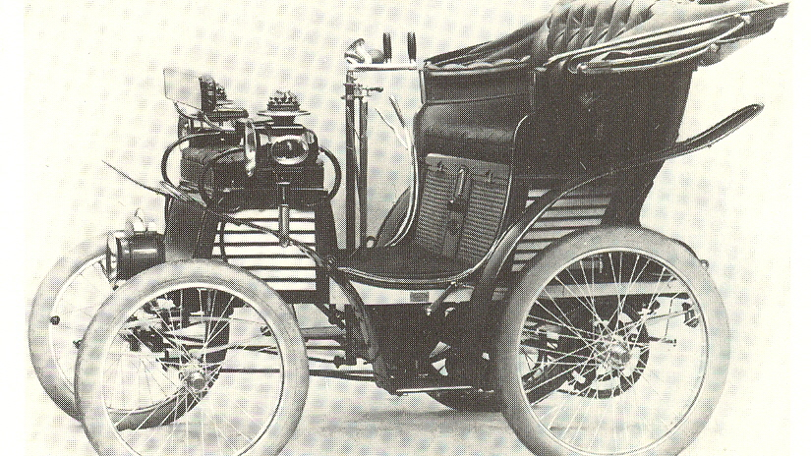
Early Cars – A little more advanced
Notes:
Steering handle changes, everything encased. 4 wheels adding lots of stability

Slide 8
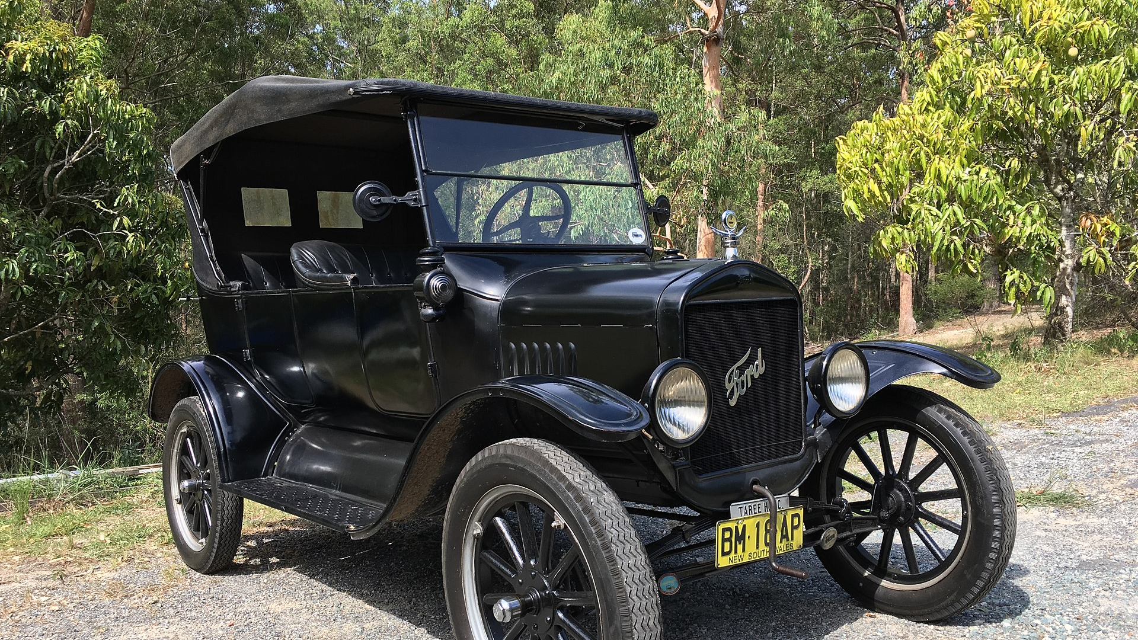
Mass production
Notes:
Ford forever changes auto manufacturing by introduce the production line, allowing for the rapid creation and iteration of the automobile.
Faster iteration resulted in spending less time R&D on common components, once it had been tested and tried through a large enough number of uses, engineers felt comfortable take parts “off the shelf”

Slide 9
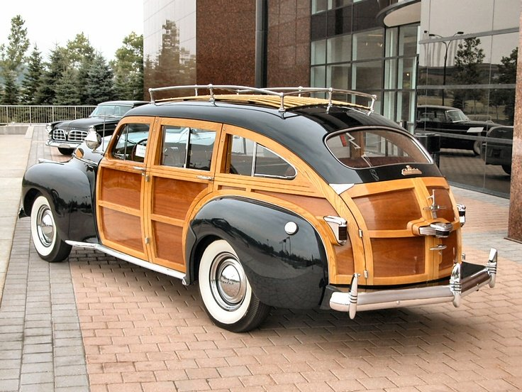
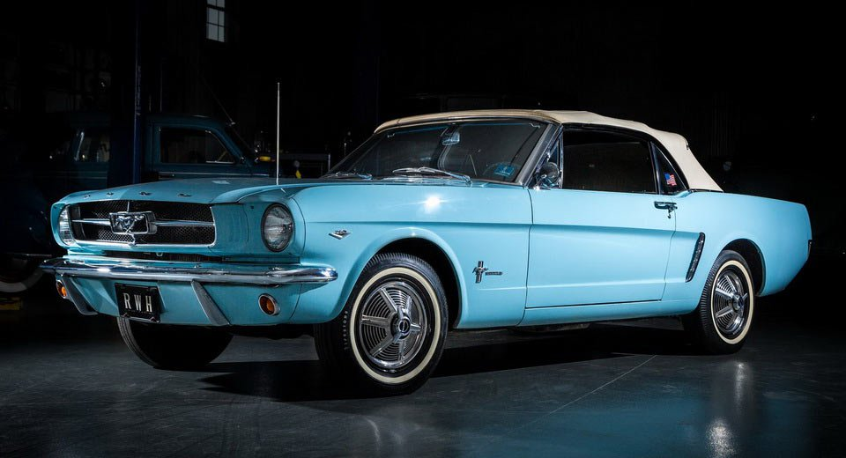
Mass production
Notes:
Awesome wagon and muscle cars!

Slide 10
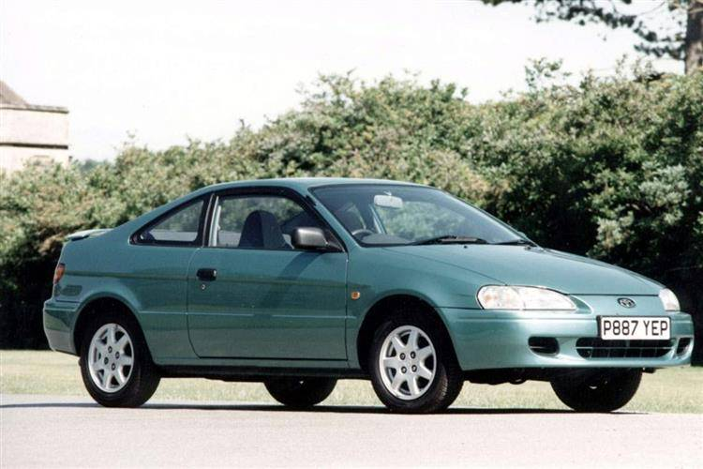
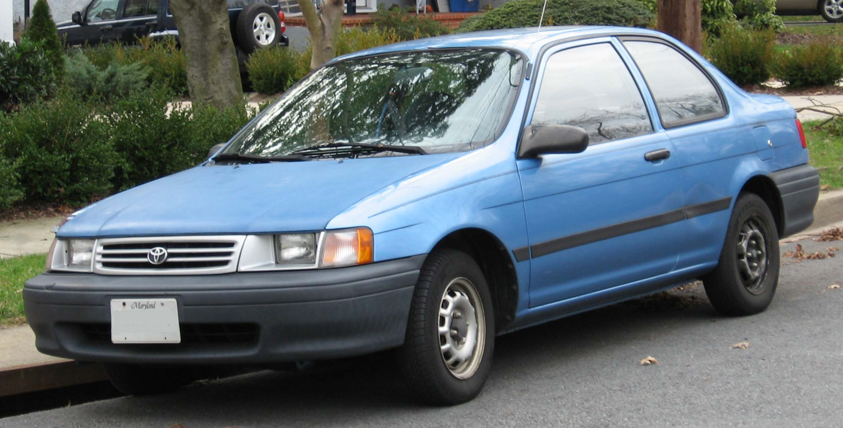
Commoditize
$11,498
$7,848
Notes:
It was easy for manufacturers to continue to rely on common designs and components for less superficial parts of the cars. They focused on what they wanted THAT car to be in the market.
Twinning starts to become common, the reuse of nearly the entire car. This would occur across models under the same manufacturer (Toyota Tercel and Pinto-thing). Sometimes even across brands (Toyota and lexus) and corporations (Toyota and Subaru).
Emails, then

Slide 11
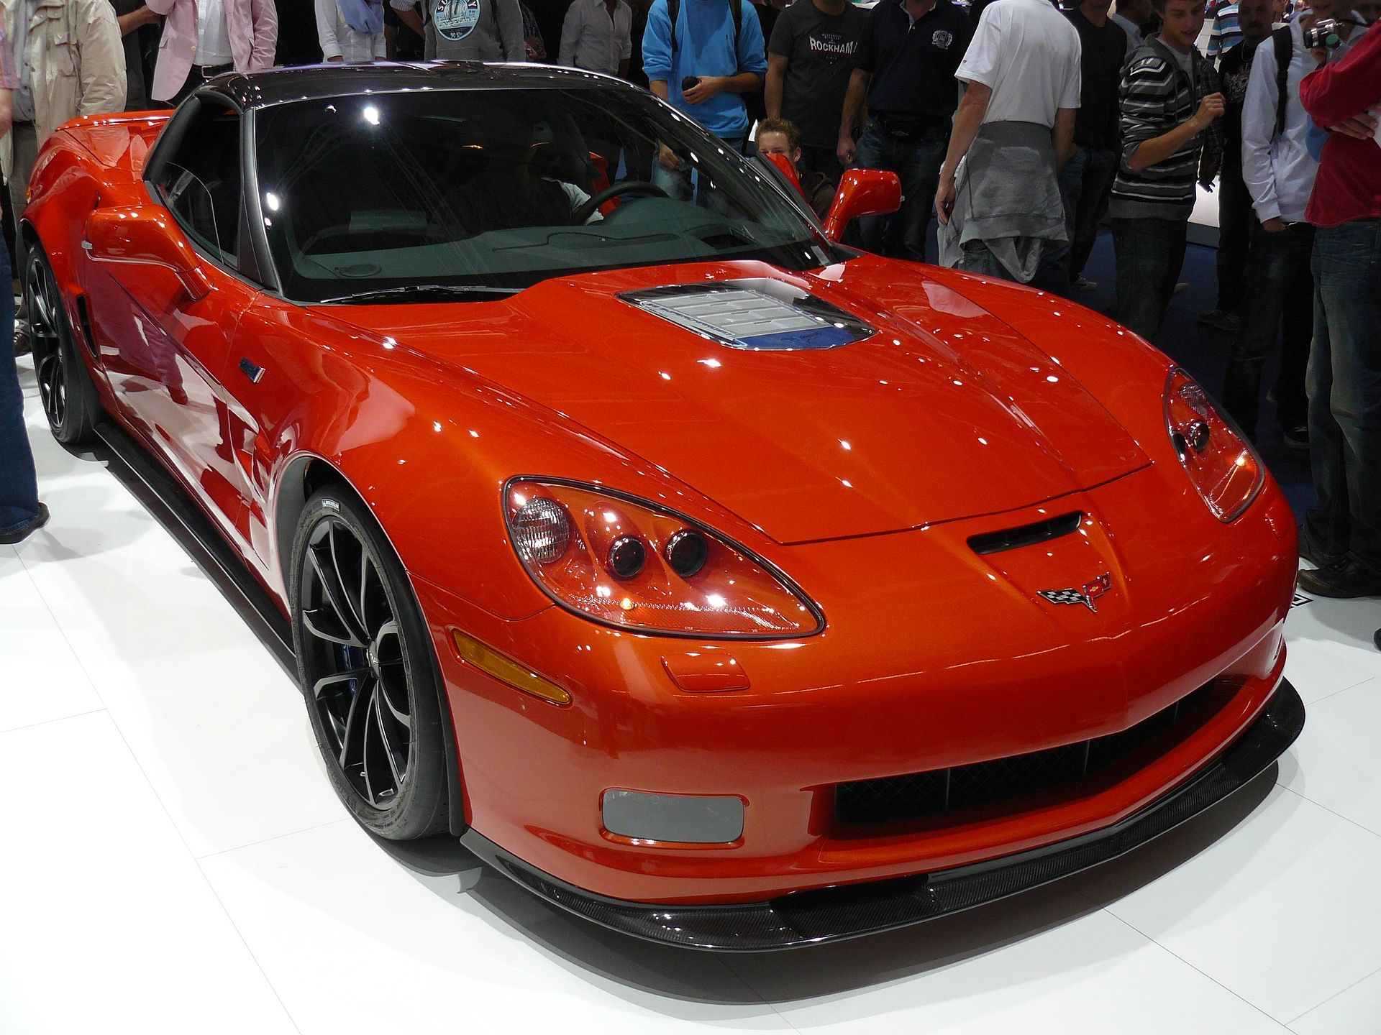
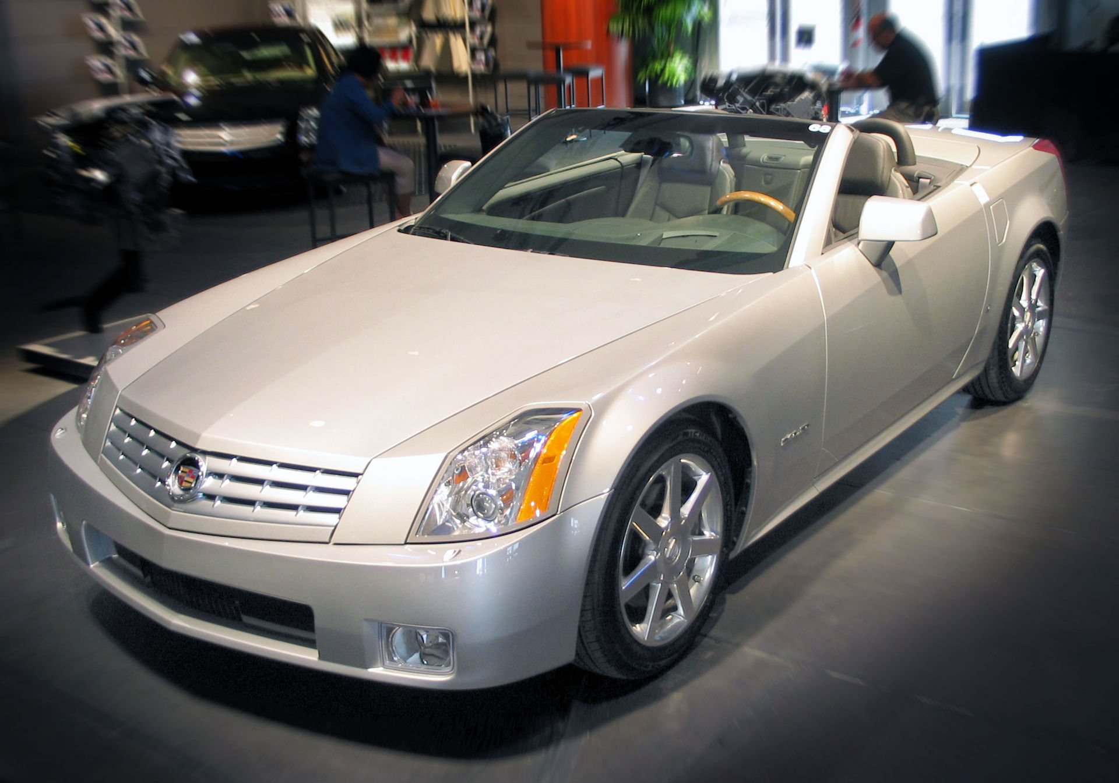
Commoditize
Notes:
Now all major auto makers have common platforms across their cars.
Michigan or California?

Slide 12
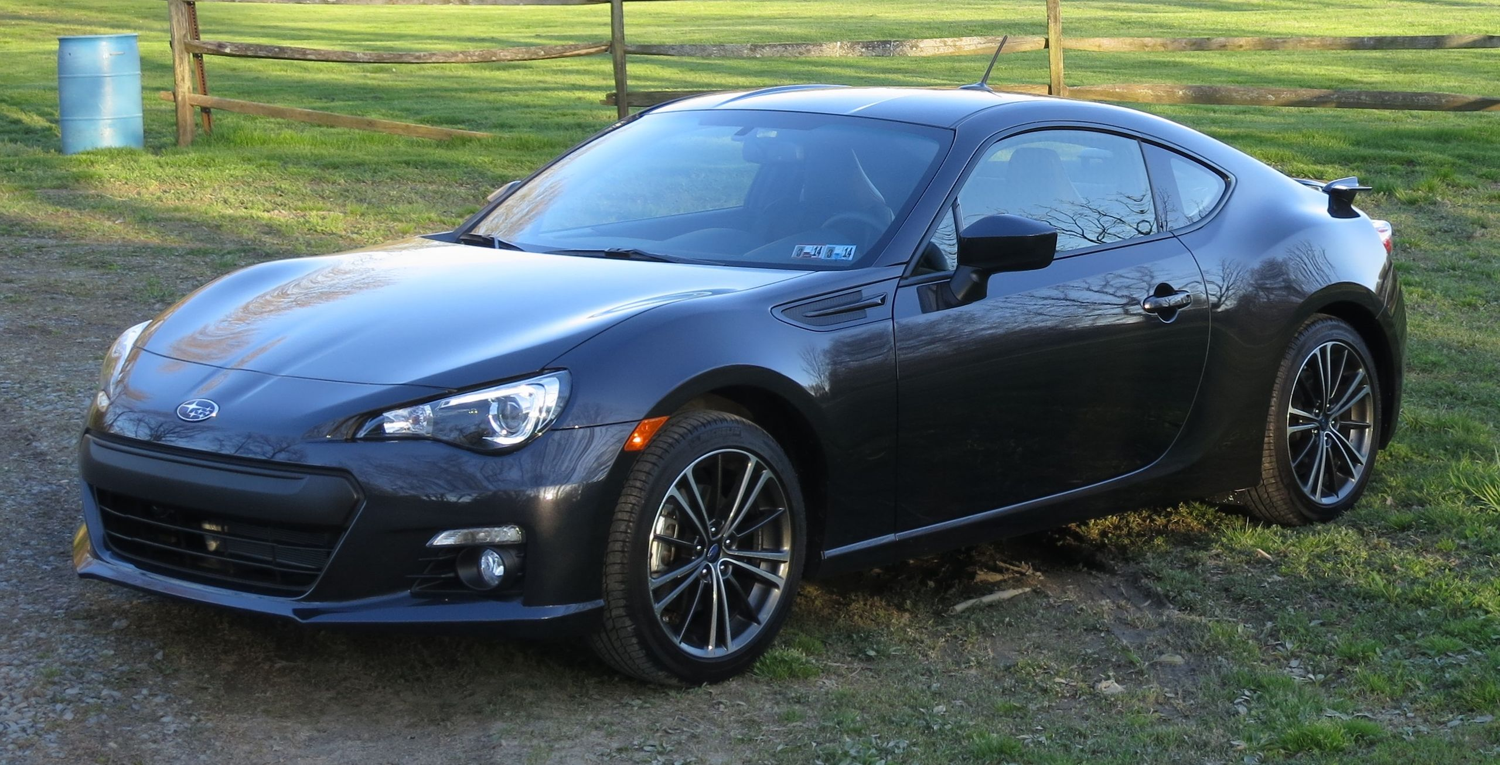
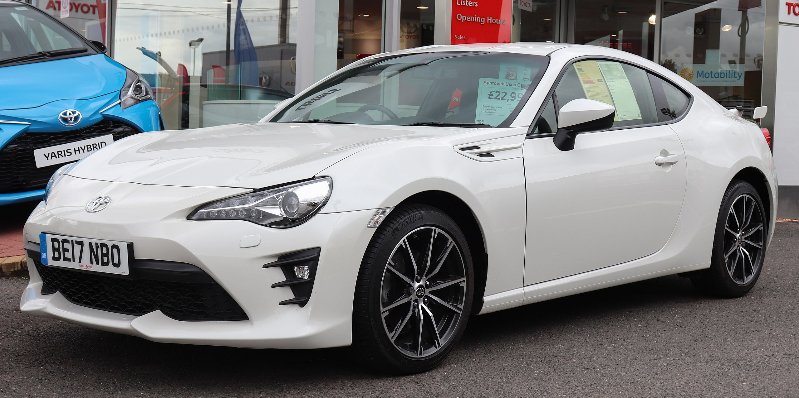
Commoditize
Notes:
Toyota or Subaru?

Slide 13
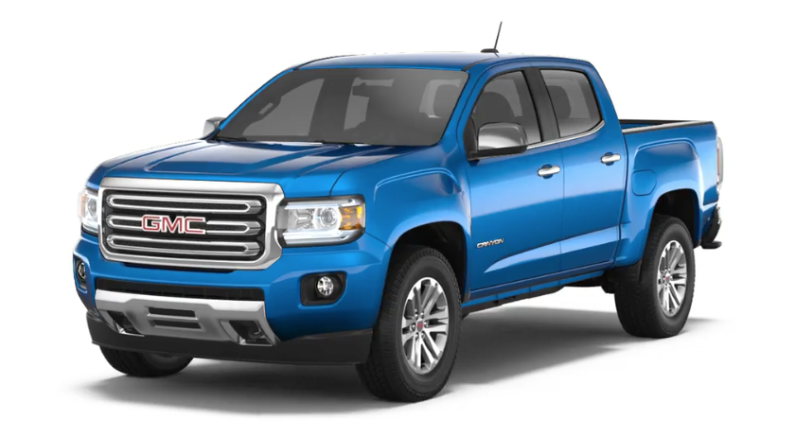
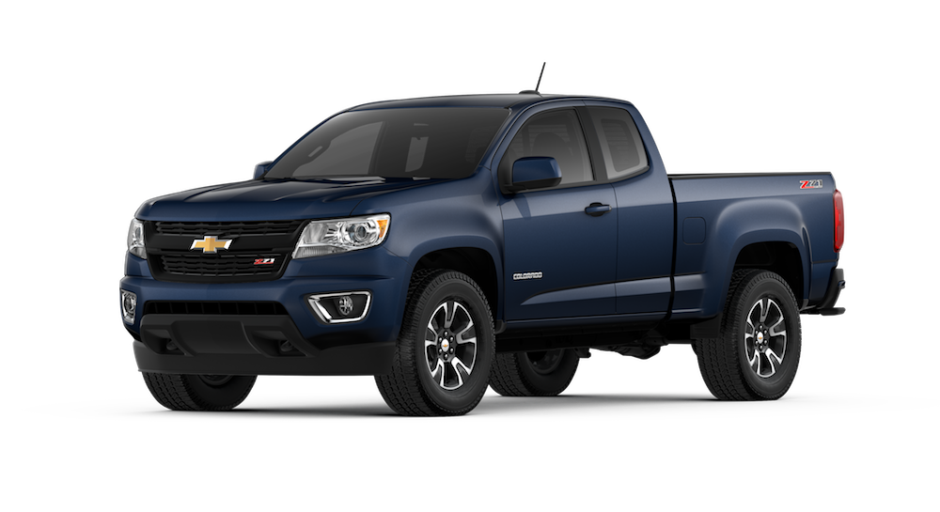
Commoditize
Notes:
GMC Canyon and Chevy Colorado
$2k difference base starting price, Chevy sells 4x as many last year

Slide 14
Specialization
Chevrolet Colorado Sales Numbers
Sales Results - USA - Colorado
Year | Jan | Feb | Mar | Apr | May | Jun | Jul | Aug | Sep | Oct | Nov | Dec | Total
2019 | 11,165 | 11,165 | 11,165 |  |  |  |  |  |  |  |  |  | 33,494
2018 | 8,011 | 8,050 | 12,798 | 13,672 | 13,672 | 13,672 | 11,654 | 11,654 | 11,654 | 10,001 | 10,001 | 10,001 | 134,842
$38,095
GMC Canyon Sales Numbers
Sales Results - USA - Canyon
Year | Jan | Feb | Mar | Apr | May | Jun | Jul | Aug | Sep | Oct | Nov | Dec | Total
2019 | 2,318 | 2,318 | 2,318 |  |  |  |  |  |  |  |  |  | 6,954
2018 | 2,171 | 2,319 | 2,723 | 3,212 | 3,212 | 3,211 | 2,808 | 2,808 | 2,808 | 2,740 | 2,740 | 2,740 | 33,492
$40,395
+ ~6%
Notes:
By cutting R&D costs to only superficial components (styling and interior) we see a highly specialized industry right now.
GMC Canyon and Chevy Colorado. Nearly identical.

Slide 15
Beginning to Highly Commoditized
1885 to 2015

Slide 16
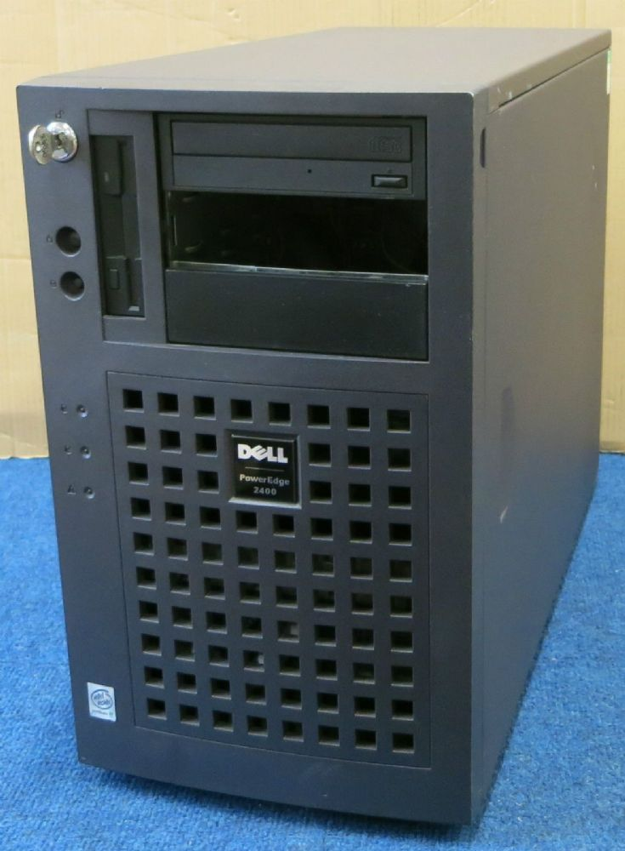
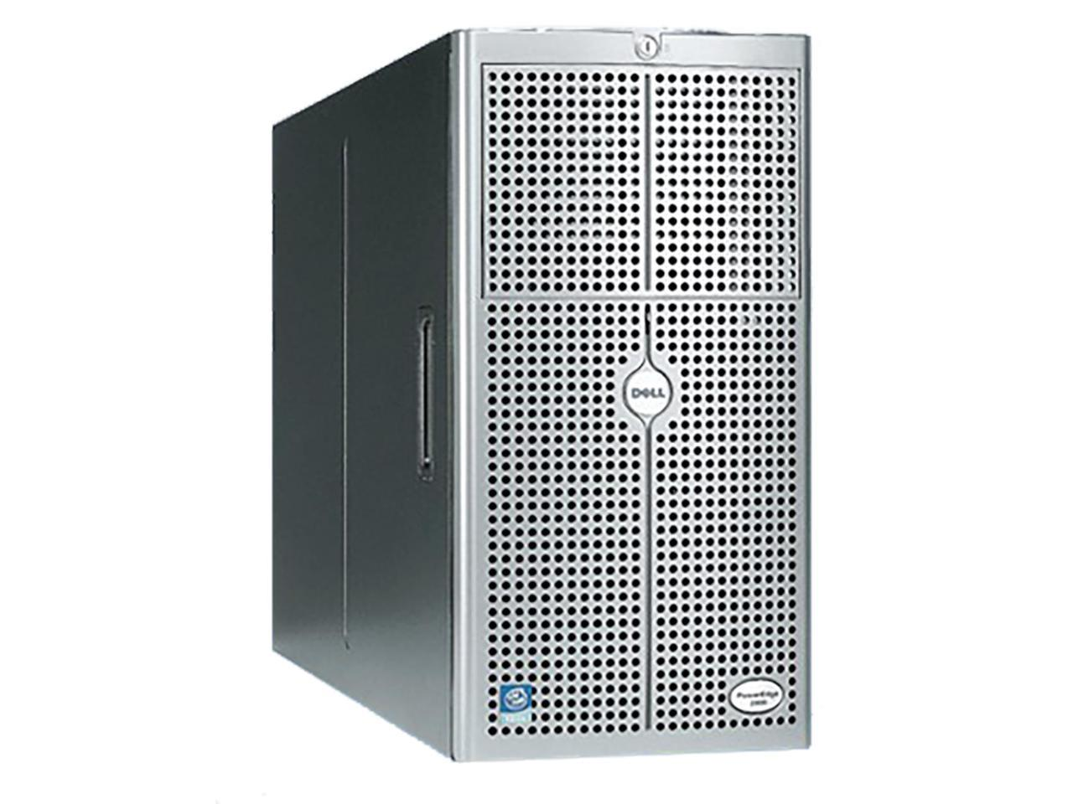
Software Systems – The Beginning
Notes:
Still bespoke. Very slow. Need a new system? Order it, wait days, put it on the network. Install software. If you’re lucky it’s a week.

Slide 17
Mass Production
Notes:
We turned physical hardware into virtual software.
Need a new system? 10 minutes.

Slide 18
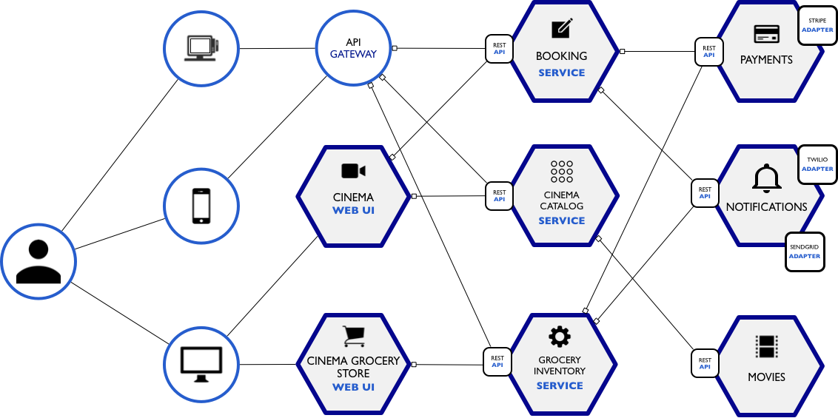
Service Oriented Architectures
Notes:
Your standard web application architecture is the Chevy Colorado of software systems. Everyone’s got one, they don’t vary too much. Container or AMI is your web tier, db is a service, sqs (pub sub) is a service, email is a service, everything is a service. Container/web server is your engine, transmission is your database. Email is your wheels, scalability is your frame.
Virtual machines with base images (EC2 with AMIs)
Service oriented architectures became dominant
Everything is a service

Slide 19
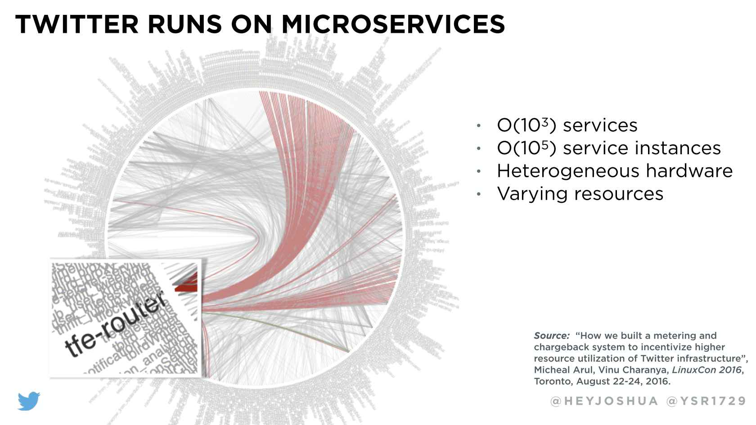

Slide 20
Serverless
The Service Oriented Architecture (SOA) has evolved to allow significant amounts of the traditional application code to be delegated to easily consumed managed services.
As the auto manufacturer now spends little on R&D for common components like shocks, brakes, frame designs, etc., Serverless allows system architects to leverage well designed and managed dbs, api endpoint services, worker processes, etc., reducing R&D and increasing TTM while reducing TCO.

Slide 21
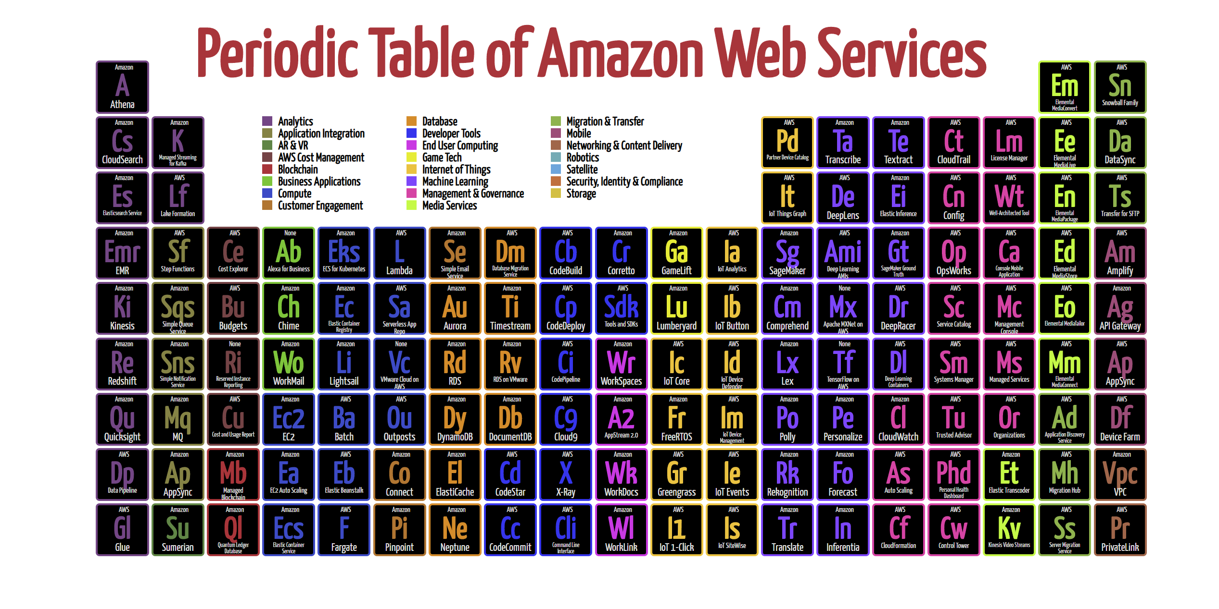
Notes:
Some services may not be listed because AWS has new features every week
Over time, per trends - costs goes down.

Slide 22

Lambda

Slide 23
Compute layer, helps with business-specific rules
Commoditize your programming
One stop shop for mobile, 3rd party, web, IoT
Security via IAM or in logic
Triggered by events or scheduled via CloudWatch
Behind the scenes: Amazon Linux 2 (EC2); dotnet uses RHEL
Lambda

Slide 24

DynamoDB

Slide 25
NoSQL database
Has feature to scale up rapidly (DAX)
Use DynamoDB Streams to react to DB changes to downstream services
Pricing based on usage
Check out videos of one-table database (link in github)
DynamoDB
Notes:
DyanmoDB streams can be used to kick off Lambdas and Kinesis Consumers
Your entire RDBMS into one DynamoDB table?

Slide 26

S3

Slide 27
The ultimate storage layer
Use as junk folder, database store (Athena/EMR/RedShift), one-offs temporary storage, regulatory mandated storage (lock files for 7 years)
99.999999999% durability (31.56 ms downtime!)
Pricing based on data-out and storage
Redundancy built-in
Replication across regions
S3

Slide 28


RDS/Aurora

Slide 29

Managed databases
Five flavors:
PostgreSQL
MySQL
MariaDB
Oracle
SQL Server
Aurora is “best version”
*new* Aurora Serverless
No user licenses
RDS/Aurora
Notes:
Security:
API Keys – 3rd party
Cognito
IAM-level signature keys

Slide 30
API Gateway

Slide 31
Entry point into AWS
REST API & WebSockets API
Test with Postman
Can throttle traffic
DDoS prevention
Pluggable authorization
API Gateway
Notes:
Security:
API Keys – 3rd party
Cognito
IAM-level signature keys

Slide 32

Cognito

Slide 33
Security layer
User pools:
Facebook
Google
Microsoft AD/SAML
OAuth
OpenID Connect
HIPAA compliant
Logins for external users
Cognito
Notes:
Logins for external users, you don’t want to use IAM for it!

Slide 34

X-Ray

Slide 35
Monitoring layer
Monitor behaviors in apps
Request tracing
Profiling
Costs money!
X-Ray
Notes:
Traces user requests through the entire serverless ecosystem
Profiling – find ways to discover issues and possibly increase performance

Slide 36

Step Functions

Slide 37
Workflow layer
Orchestration
Automate recurring tasks
Done in orderly manner
Resilient
BPM-like tooling
Step Functions
Notes:
Hook up events to it
Two separate functions, combine into one, then execute an event downstream

Slide 38
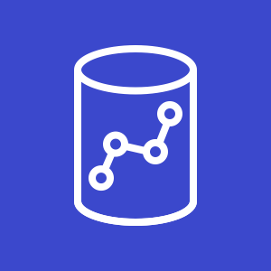
RedShift

Slide 39
Datwarehouse
MPP: Massively Parallel Processing
JDBC/ODBC connectivity
DBLINK sync with PostgreSQL RDS
Scale up by adding more nodes
Redshift Spectrum can go through unstructured data in S3
AWS does the maintenance

Slide 40
Demo Workflow

Slide 41
Going Deeper
What else can we do?
Other building blocks we might need
Data analysis layer (Big Data: Athena, EMR)
EC2
Email/notifications
Real-time events
CDK (can demo if time)
Notes:
Let’s say scope of project expands
RedShift
RDS
Step Functions
CloudWatch triggers
Cognito to add logins
EC2 instances (easy way out)
CDK – devops orchestration

Slide 42


Q&A
https://github.com/mbonig/aws-workflow-preso
@mattbonig
@robcube

